Slide 1
Quantization, Sparsity and Pruning
Andrew W. Rose
Image credit to Sophia Shao @ UC Berkley & Vivienne Sze @ MIT

Slide 2
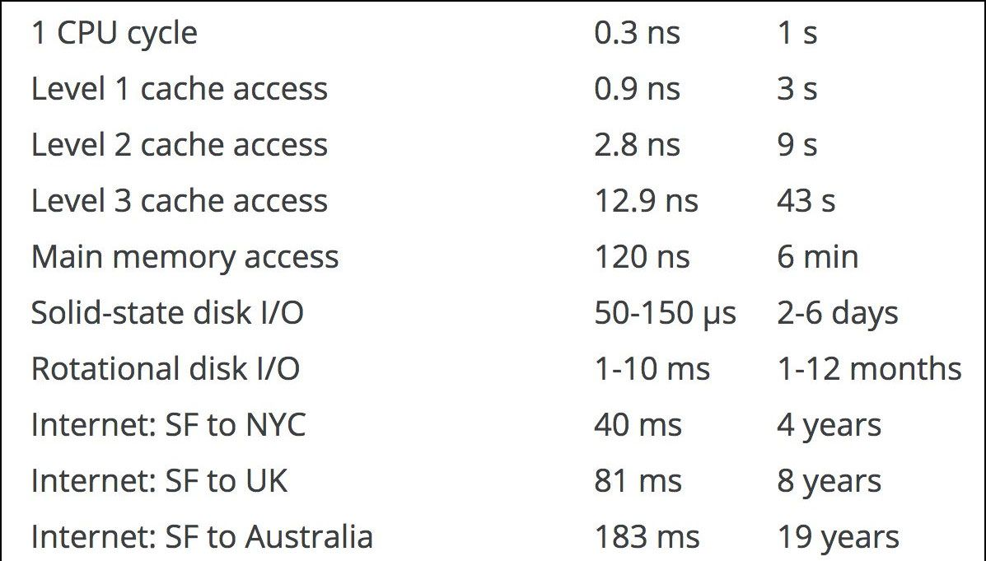
Recall
Accessing DRAM is EXPENSIVE
Accessing DRAM is SLOW

Slide 3
Scientific Notation (in Decimal)
Mantissa
Exponent
3.14_{ten} × 10³²¹⁰
ten
Decimal point
Radix (Base)
Normalized form has exactly one, non-zero digit to left of decimal point
1/1,000,000,000 = 1.0 x 10⁻⁹ = 0.1 x 10⁻⁸ = 10.0 x 10⁻¹⁰ = …

Slide 4
Scientific Notation (in Decimal)
Mantissa
Exponent
3.14_{ten} × 10³²¹⁰
ten
Decimal point
Radix (Base)
Normalized form has exactly one, non-zero digit to left of decimal point
1/1,000,000,000 = 1.0 x 10⁻⁹ = 0.1 x 10⁻⁸ = 10.0 x 10⁻¹⁰ = …
Normalised

Slide 5
Scientific Notation (in Decimal)
Mantissa
Exponent
3.14_{ten} × 10³²¹⁰
ten
Decimal point
Radix (Base)
Normalized form has exactly one, non-zero digit to left of decimal point
1/1,000,000,000 = 1.0 x 10⁻⁹ = 0.1 x 10⁻⁸ = 10.0 x 10⁻¹⁰ = …
Normalised
Denormalised

Slide 6
Scientific Notation (in Binary)
Mantissa
Exponent
1.01_{two} × 2³²¹⁰
ten
Binary point
Radix (Base)
Normalized form has exactly one, non-zero digit to left of binary point

Slide 7
Scientific Notation (in Binary)
Mantissa
Exponent
1.01_{two} × 2³²¹⁰
ten
Binary point
Radix (Base)
Normalized form has exactly one, non-zero digit to left of binary point
But in Binary this is always a 1 – We do not need to store it!

Slide 8
Scientific Notation (in Binary)
Mantissa
Exponent
1.01_{two} × 2³²¹⁰
ten
Binary point
Radix (Base)
Normalized form has exactly one, non-zero digit to left of binary point
But in Binary this is always a 1 – We do not need to store it!
UNLESS YOU ARE TRYING TO REPRESENT ZERO

Slide 9
Scientific Notation (in Binary)
Mantissa
Exponent
1.01_{two} × 2³²¹⁰
ten
Binary point
Radix (Base)
Normalized form has exactly one, non-zero digit to left of binary point
But in Binary this is always a 1 – We do not need to store it!
UNLESS YOU ARE TRYING TO REPRESENT ZERO
In computing this is called floating point, because the binary point "floats" up or down to behind the most-significant "1"

Slide 10
Floating-Point Representation: IEEE 754
Single precision, FP32 = 32bits
±1.x…x_{two} × 2^{y…y}
two
s | y | y | y | y | y | y | y | y | x | x | x | x | x | x | x | x | x | x | x | x | x | x | x | x | x | x | x | x | x | x | x
1 sign bit
8-bit exponent
23-bit significand

Slide 11
Floating-Point Representation: IEEE 754
Single precision, FP32 = 32bits
"Special" values to define denormalised numbers, ±zero, ±infinity, and quiet and signalling not-a-number
±1.x…x_{two} × 2^{y…y}
two
s | y | y | y | y | y | y | y | y | x | x | x | x | x | x | x | x | x | x | x | x | x | x | x | x | x | x | x | x | x | x | x
1 sign bit
8-bit exponent
23-bit significand

Slide 12
IEEE 754
IEEE FP16 = Half precision
s | y | y | y | y | y | x | x | x | x | x | x | x | x | x | x
Standardised by IEEE in 1985
1 sign bit
5-bit exponent
10-bit significand
IEEE FP32 = Single precision
s | y | y | y | y | y | y | y | y | x | x | x | x | x | x | x | x | x | x | x | x | x | x | x | x | x | x | x | x | x | x | x
1 sign bit
8-bit exponent
23-bit significand
IEEE FP64 = Double precision
s | y | y | y | y | y | y | y | y | y | y | y | x | x | x | x | x | x | x | x | x | x | x | x | x | x | x | x | x | x | x | x
x | x | x | x | x | x | x | x | x | x | x | x | x | x | x | x | x | x | x | x | x | x | x | x | x | x | x | x | x | x | x | x
1 sign bit
11-bit exponent
52-bit significand

Slide 13
But this is an arbitrary choice…
IEEE FP16 = Half precision
s | y | y | y | y | y | x | x | x | x | x | x | x | x | x | x
“neural networks are far more sensitive to the size of the exponent than that of the mantissa”
1 sign bit
5-bit exponent
10-bit significand
IEEE FP32 = Single precision
Wang and Kanwar, 2019
s | y | y | y | y | y | y | y | y | x | x | x | x | x | x | x | x | x | x | x | x | x | x | x | x | x | x | x | x | x | x | x
1 sign bit
8-bit exponent
23-bit significand
Google bfloat16
s | y | y | y | y | y | x | x | x | x | x | x | x | x | x | x
1 sign bit
8-bit exponent
7-bit significand

Slide 14
Floating point operation
(A × 2ª) × (B × 2^{b})

Slide 15
Floating point operation
(A × 2ª) × (B × 2^{b}) = (A × B) × (2ª × 2^{b}) = (A × B) × 2^{(a + b)}
For FP32, that's
1× 8-bit addition 1× 24-bit multiplication

Slide 16
Floating point operation
Renormalisation
(A × 2ª) × (B × 2^{b}) = (A × B) × (2ª × 2^{b}) = (A × B) × 2^{(a + b)} → (C × 2^{c})
For FP32, that's
1× 8-bit addition 1× 24-bit multiplication

Slide 17
Floating point operation
Renormalisation
(A × 2ª) × (B × 2^{b}) = (A × B) × (2ª × 2^{b}) = (A × B) × 2^{(a + b)} → (C × 2^{c})
(A × 2ª) + (B × 2^{b})

Slide 18
Floating point operation
Renormalisation
(A × 2ª) × (B × 2^{b}) = (A × B) × (2ª × 2^{b}) = (A × B) × 2^{(a + b)} → (C × 2^{c})
(A × 2ª) + (B × 2^{b}) → (A' × 2^{x}) + (B' × 2^{x}) = (A' + B') × 2^{x}
Denormalisation

Slide 19
Floating point operation
Renormalisation
(A × 2ª) × (B × 2^{b}) = (A × B) × (2ª × 2^{b}) = (A × B) × 2^{(a + b)} → (C × 2^{c})
(A × 2ª) + (B × 2^{b}) → (A' × 2^{x}) + (B' × 2^{x}) = (A' + B') × 2^{x} → (D × 2^{d})
Denormalisation
Renormalisation

Slide 20
Floating point operation
Renormalisation
(A × 2ª) × (B × 2^{b}) = (A × B) × (2ª × 2^{b}) = (A × B) × 2^{(a + b)} → (C × 2^{c})
(A × 2ª) + (B × 2^{b}) → (A' × 2^{x}) + (B' × 2^{x}) = (A' + B') × 2^{x} → (D × 2^{d})
The constant need to denormalise and renormalise means that floating point is more costly and has higher latency than integer/fixed point operations
Denormalisation
Renormalisation

Slide 21
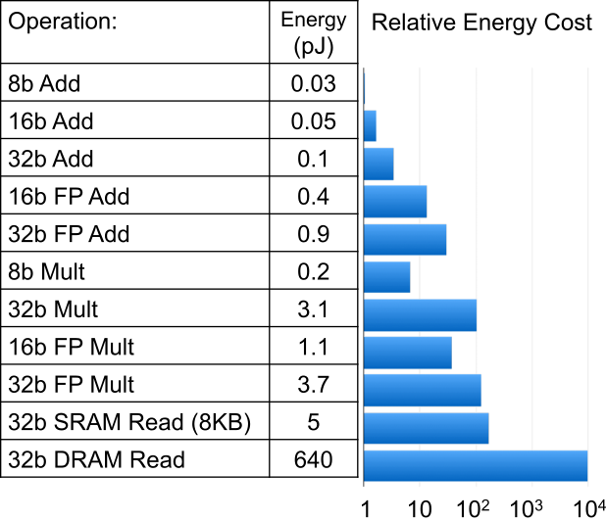
Cost of Operations
Computing’s Energy Problem (and what we can do about it Horowitz, ISSCC 2014
×9
×1.2

Slide 22
Cost of Operations
Moving from FP32 to I8 reduces a MAC from 4.6pJ to 0.23pJ
20-fold energy saving

Slide 23
Cost of Operations
Moving from FP32 to I8 reduces a MAC from 4.6pJ to 0.23pJ
20-fold energy saving
Plus gives you 4-fold energy saving on RAM accesses

Slide 24
Cost of Operations
Moving from FP32 to I8 reduces a MAC from 4.6pJ to 0.23pJ
20-fold energy saving
Plus gives you 4-fold energy saving on RAM accesses
Plus you can store 4× as many in your local cache

Slide 25
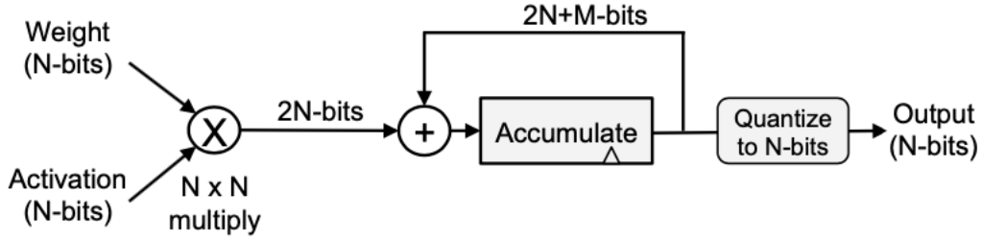
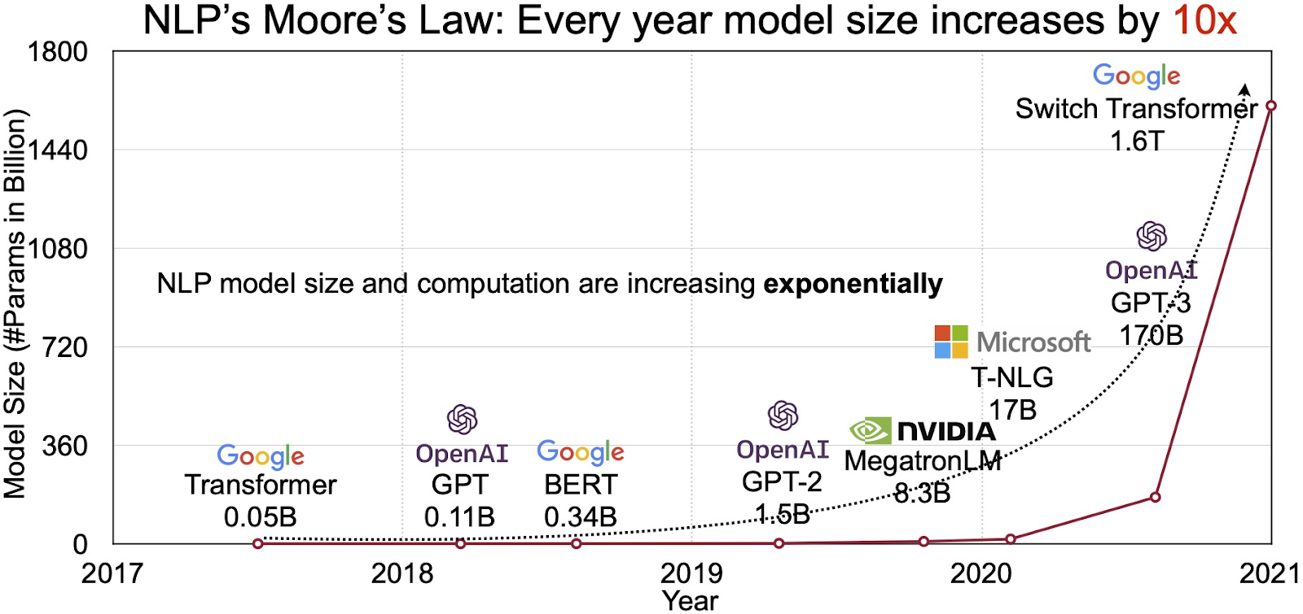
Fixed point
But nothing comes for free…
Accumulation means that the output is bigger than the input
And 1.6 trillion parameters means a lot of accumulations
We are free to have a different number of fractional bits in each layer
In hardware, we can choose our number of bits (somewhat) arbitrarily

Slide 26
Two quantization options
Map |max| to 127
Significant accuracy loss in general

Slide 27
Two quantization options
Map |max| to 127
Saturate above |threshold| to 127
Significant accuracy loss in general
Weights: no accuracy improvement
Activations: improved accuracy
How do you choose |threshold|?

Slide 28
How do you choose |threshold|?
Averaging: using a (weighted) average of min/max values of samples in the batch instead of the global min/max
Mean ± Nσ: Take N standard deviation from the mean

Slide 29
How do you choose |threshold|?
Averaging: using a (weighted) average of min/max values of samples in the batch instead of the global min/max
Mean ± Nσ: Take N standard deviation from the mean
But why bother?

Slide 30
Quantization-Aware Training
The whole point of a neural network is that training makes it adapt to make the most of it's situation
Make the training aware that the inference is going to be quantized
“Simulate” quantization effects in the forward pass
Weights and biases are updated in floating point during backpropagation so that they can be nudged by small amounts
Typically performs better than post-training quantization

Slide 31
Impact on Accuracy
Gysel et al., Ristretto, ICLR 2016
Fine-tuned for integer
Without fine-tuning

Slide 32
Go even smaller… Ternary nets
Ternary Weight Nets (TWN)
Weights {-w, 0, w}, except first and last layers are 32-bit float
Activations: 32-bit float
Accuracy loss: 3.7% on AlexNet
[Li et al., arXiv 2016]
Trained Ternary Quantization (TTQ)
Weights {-w1, 0, w2}, except first and last layers are 32-bit float
Activations: 32-bit float
Accuracy loss: 0.6% on AlexNet
[Zhu et al., ICLR 2017]

Slide 33
Go smaller still… Binary nets
Binary Weight Nets (BWN)
Weights {-α, α}, except first and last layers are 32-bit float
Activations: 32-bit float
α determined by the l1-norm of all weights in a filter
Accuracy loss: 0.8% on AlexNet
XNOR-Net
Weights {-α, α}
Activations {-β_{i}, β_{i}}, except first and last layers are 32-bit float
β_{i} determined by the l1-norm of all activations across channels for given position i of the input feature map
Scale factors (α, β_{i}) can change per filter or position in filter
Accuracy loss: 11% on AlexNet
[Rastegari et al., BWN & XNOR-Net, ECCV 2016]
Binary Connect (BC)
Weights {-1,1}, Activations 32-bit float
MAC → addition/subtraction
Accuracy loss: 19% on AlexNet
[Courbariaux, NeurIPS 2015]
Binarized Neural Networks (BNN)
Weights {-1,1}, Activations {-1,1}
MAC → XNOR
Accuracy loss: 29.8% on AlexNet
[Courbariaux, arXiv 2016]

Slide 34
Zeros
With integer/fixed point formats, small weights become truly zero

Slide 35
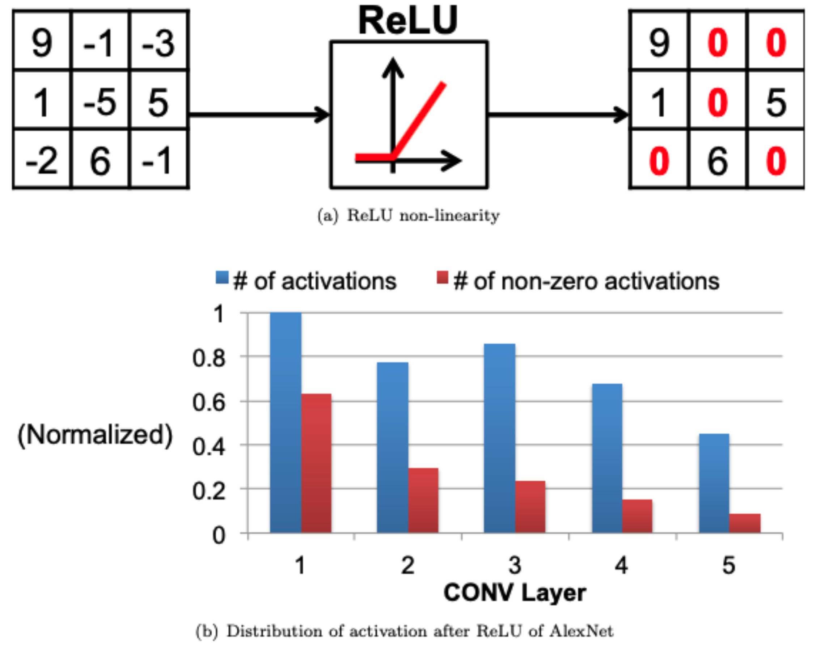
Zeros
With integer/fixed point formats, small weights become truly zero
RELU has become the activation function of choice
Normalized count
Convolution Layer

Slide 36
Recall
Accessing DRAM is EXPENSIVE
Accessing DRAM is SLOW
Why bother reading zeros from RAM when they do not contribute to the output?

Slide 37
Sparse representations
Again – more than one way to skin that cat

Slide 38
Bitmask Encoding
Using 1-bit/element to indicate whether the value is zero or not.
Example: NVDLA
Pros: simple and regular
Cons: fixed overhead independent of density
1/8 overhead for 8-bit values

Slide 39
Run-Length Encoding
Runs of data (sequences where the same data value, e.g., 0, occurs in consecutive elements) are stored as a single value and count
Example: Eyeriss
Pros: compression rate linear with #non-zero elements
Cons: overhead: #non-zero × ceil( log₂(max. run-length) )

Slide 40
Compressed-Sparse Column (CSC) Encoding
Represents a matrix with 3 one-dimension arrays
Bound of each column (size: #columns)
Row index for each non-zero element within the column (size: #non-zero)
Non-zero values (size: #non-zero)
Pros: allow fast column access

Slide 41
Compressed-Sparse Column (CSC) Encoding
Represents a matrix with 3 one-dimension arrays
Bound of each column (size: #columns)
Row index for each non-zero element within the column (size: #non-zero)
Non-zero values (size: #non-zero)
Pros: allow fast column access

Slide 42
Compressed-Sparse Column (CSC) Encoding
Represents a matrix with 3 one-dimension arrays
Bound of each column (size: #columns)
Row index for each non-zero element within the column (size: #non-zero)
Non-zero values (size: #non-zero)
Pros: allow fast column access

Slide 43
Compressed-Sparse Column (CSC) Encoding
Represents a matrix with 3 one-dimension arrays
Bound of each column (size: #columns)
Row index for each non-zero element within the column (size: #non-zero)
Non-zero values (size: #non-zero)
Pros: allow fast column access

Slide 44
Compressed-Sparse Column (CSC) Encoding
Represents a matrix with 3 one-dimension arrays
Bound of each column (size: #columns)
Row index for each non-zero element within the column (size: #non-zero)
Non-zero values (size: #non-zero)
Pros: allow fast column access

Slide 45
Compressed-Sparse Column (CSC) Encoding
Represents a matrix with 3 one-dimension arrays
Bound of each column (size: #columns)
Row index for each non-zero element within the column (size: #non-zero)
Non-zero values (size: #non-zero)
Pros: allow fast column access

Slide 46
Compressed-Sparse Column (CSC) Encoding
Represents a matrix with 3 one-dimension arrays
Bound of each column (size: #columns)
Row index for each non-zero element within the column (size: #non-zero)
Non-zero values (size: #non-zero)
Pros: allow fast column access

Slide 47
Compressed-Sparse Column (CSC) Encoding
Represents a matrix with 3 one-dimension arrays
Bound of each column (size: #columns)
Row index for each non-zero element within the column (size: #non-zero)
Non-zero values (size: #non-zero)
Pros: allow fast column access

Slide 48
Compressed-Sparse Column (CSC) Encoding
Represents a matrix with 3 one-dimension arrays
Bound of each column (size: #columns)
Row index for each non-zero element within the column (size: #non-zero)
Non-zero values (size: #non-zero)
Pros: allow fast column access

Slide 49
An aside
This is an example of IMPLICIT information
You can use *WHERE* the information is within a data-structure to store more information than the amount of memory you use
Compare to EXPLICIT information
All data is stored explicitly

Slide 50
Compressed-Sparse Row (CSR) Encoding
Represents a matrix with 3 one-dimension arrays
Bound of each row (size: #rows)
Column index for each non-zero element within the row (size: #non-zero)
Non-zero values (size: #non-zero)
Pros: allow fast row access

Slide 51
Doubly compressed sparse row/column (DCSR/DCSC) Encoding
Can equivalently store bounds to remove entirely empty rows/columns
DCSR

Slide 52
Tensor storage format
Can extend the concept to any Tensor (multi-dimensional array)
Separately designate each dimension as dense or sparse
Specify the order in which dimensions are stored
E.g. CSR is a row-dense, column-sparse format.

Slide 53
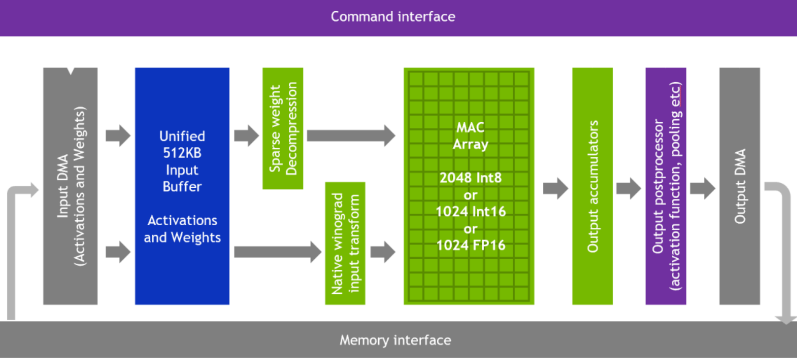
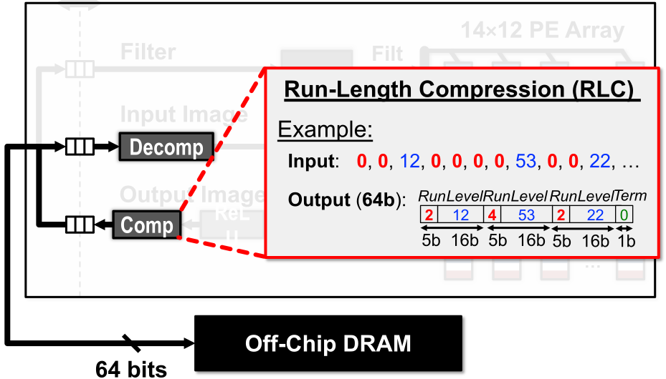
The simplest solution: I/O Compression
For example:
NVDLA
Eyeriss (Chen et al., ISSCC 2016)
Matrix operations on uncompressed matrix
Uncompressed
Compressed

Slide 54
Or you can go hardcore and multiply sparse on sparse
Calculate in parallel which multiplications are non-zero and priority-encode them
SNAP

Slide 55
Or you can go hardcore and multiply sparse on sparse
For CNNs, all non-zero activations must (at some point in time) be multiplied by all non-zero weights
The lack of alignment in IA & W results in a large number of scattered partial sums
Need arbitration logic to send to corresponding output SRAM.
SCNN

Slide 56
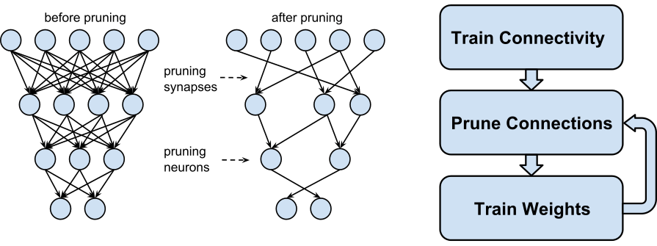
Pruning – Make Weights Sparse
Example: AlexNet
Weight Reduction: CONV layers 2.7×, FC layers 9.9×
Most reduction on fully connected layers
Overall: 9× weight reduction, 3× MAC reduction

Slide 57
Other ways to induce sparsity
Don't reinvent the wheel
The digital image people have been looking at this stuff for a long time
Exploit Spatial Correlation of Inputs
Delta code neighbouring values resulting in many zeros for uniform areas
Works for any activation field, not just input image

Slide 58
Other ways to save on compute
Don't reinvent the wheel
The digital video people have been looking at this stuff for a long time
Exploit Temporal Correlation of Inputs
Reduce amount of computation if there is temporal correlation between frames
Application specific (e.g. videos) – requires that the same operation is done for each frame (not always the case)

Slide 59
Exploit Redundant Weights
Repeated weight values get more likely the lower the precision we use
Pre-process to reorder weights
Ok since weights are known
Perform addition before multiplication to reduce number of multiplies and RAM accesses
Example: Input = [1 2 3] and filter [A B A]
Typical processing: (A×1) + (B×2) + (A×3)
3 multiplies and 3 weight reads
We can reorder to give: (A×(1+3)) + (B×1)
2 multiplies and 2 weight reads

Slide 60
Exploit ReLU
If we are using ReLU as our activation function
We can order the weights and inputs by sign so that if the partial sum goes negative the output of ReLU will be guaranteed to be (or be statistically likely to be) 0.
Can terminate accumulation early

Slide 61
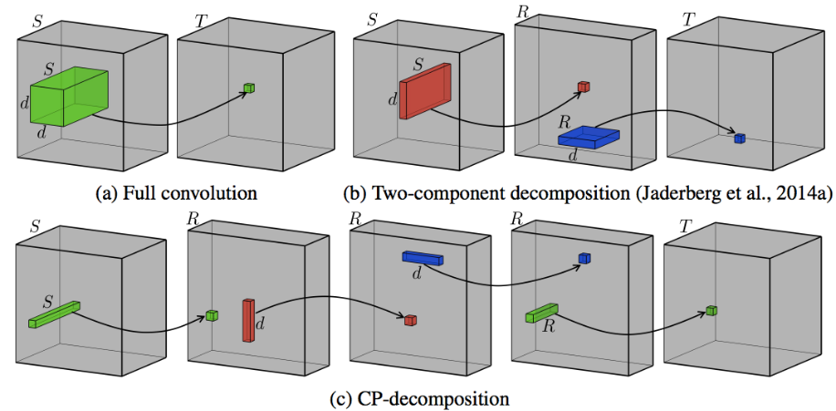
Decompose Convolutions
Break large convolutional layers into a series of smaller convolutional layers
Fewer weights, but same effective receptive field
After training, perform low-rank approximation by applying tensor decomposition to weight kernel; then fine-tune weights for accuracy

Slide 62
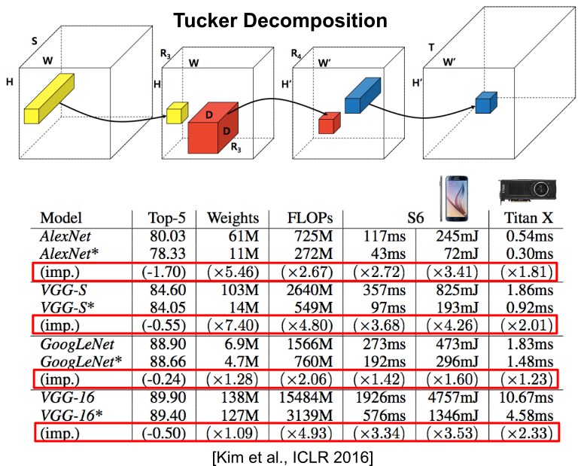
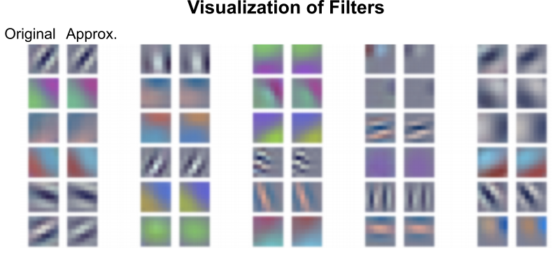
Decompose Convolutions
For example: AlexNet
Speed up by 1.6 – 2.7× on CPU/GPU for CONV1, CONV2 layers
Reduce size by 5 – 13× for FC layer
<1% drop in accuracy
Particularly effective for low-power processors

